Slide 1
Divide and Conquer
Notes:
‹#›

Slide 2
Divide and Conquer
Divide the problem into a number of subproblems
Conquer the subproblems (solve them)
Combine the subproblem solutions to get the solution to the original problem
Note: often the “conquer” step is done recursively

Slide 3
Divide and Conquer
A general methodology for using recursion to design efficiently algorithms
It solves a problem by:
Dividing the data into parts
Finding sub solutions for each of the parts
Constructing the final answer from the sub solutions

Slide 4
Divide and Conquer
A problem of size n
Subproblem 1 of size n/2
subproblem 2 of size n/2
A solution to subproblem 1
A solution to subproblem 2
a solution to the original problem

Slide 5
Divide and Conquer Algo.
Divide the problem into a number of subproblems
Subproblems must of same type
Subproblems do not need to overlap
Conquer by solving sub-problems recursively. If the sub-problems are small enough, solve them in brute force fashion
Combine the solutions of sub-problems into a solution of the original problem

Slide 6
Divide and Conquer
For divide-and-conquer algorithms the running time is mainly affected by 3 criteria:
The number of sub-instance into which a problem is split.
The ratio of initial problem size to sub-problem size.
The number of steps required to divide the initial instance and to combine sub solutions.

Slide 7
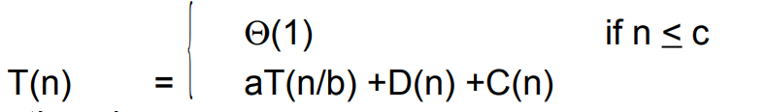

Analyzing Divide and Conquer Algo.
When an algorithm contains a recursive call to itself, its running time can often be described by a recurrence equation which describes the overall running time on a problem of size n in terms of the running time on smaller inputs.
For divide-and-conquer algorithms, we get recurrences that looks like:

Slide 8
where a=the number of subproblems we break the problem into
n/b=the size of the subproblems (in terms of n)
D(n) is the time to divide the problem of size n into the subproblems
C(n) is the time to combine the subproblem solutions to get the answer for the problem of size n

Slide 9
Example: Divide and Conquer
Binary Search
Heap Construction
Tower of Hanoi
Exponentiation
Fibonacci Sequence
Quick sort
Merge Sort
Multiplying large integers
Matrix Multiplication
Closest Pairs

Slide 10
Merge Sort
Notes:
‹#›

Slide 11
Merge Sort
Recursive in structure
Divide the problem into subproblems that are similar to the original but smaller in size
Conquer the subproblems by solving them recursively. If they are small enough, just solve them in a straightforward manner.
Combine the solutions to create a solution to the original problem

Slide 12
An Example: Merge Sort
Sorting Problem: Sort a sequence of n element into non-decreasing order.
Divide: Divide the n-element sequence to be sorted into two subsequences of n/2 elements each
Conquer: Sort the two subsequences recursively using merge sort
Combine: Merge the two sorted subsequences to produce the sorted.

Slide 13
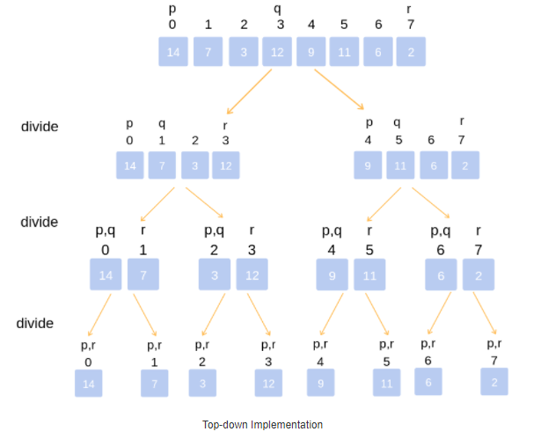
An Example: Merge Sort
Notes:
Divide the unsorted list into n sublists, each comprising 1 element (a list of 1 element is supposed sorted).

Slide 14
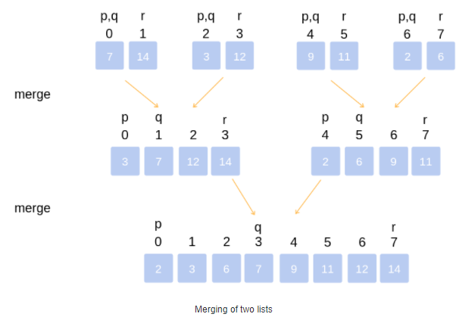
An Example: Merge Sort
Notes:
Repeatedly merge sublists to produce newly sorted sublists until there is only 1 sublist remaining. This will be the sorted list.

Slide 15
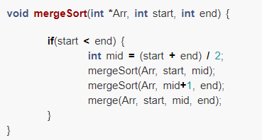
Implementation Of Merge Sort

Slide 16
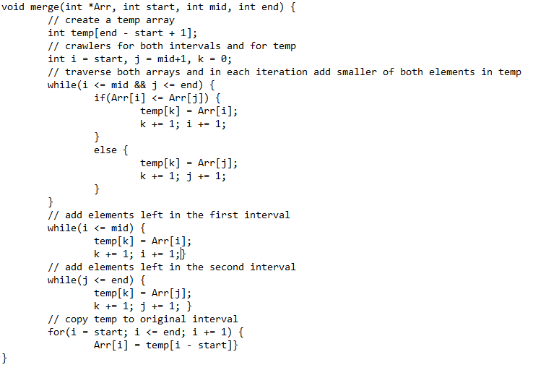
Implementation Of Merge Sort

Slide 17
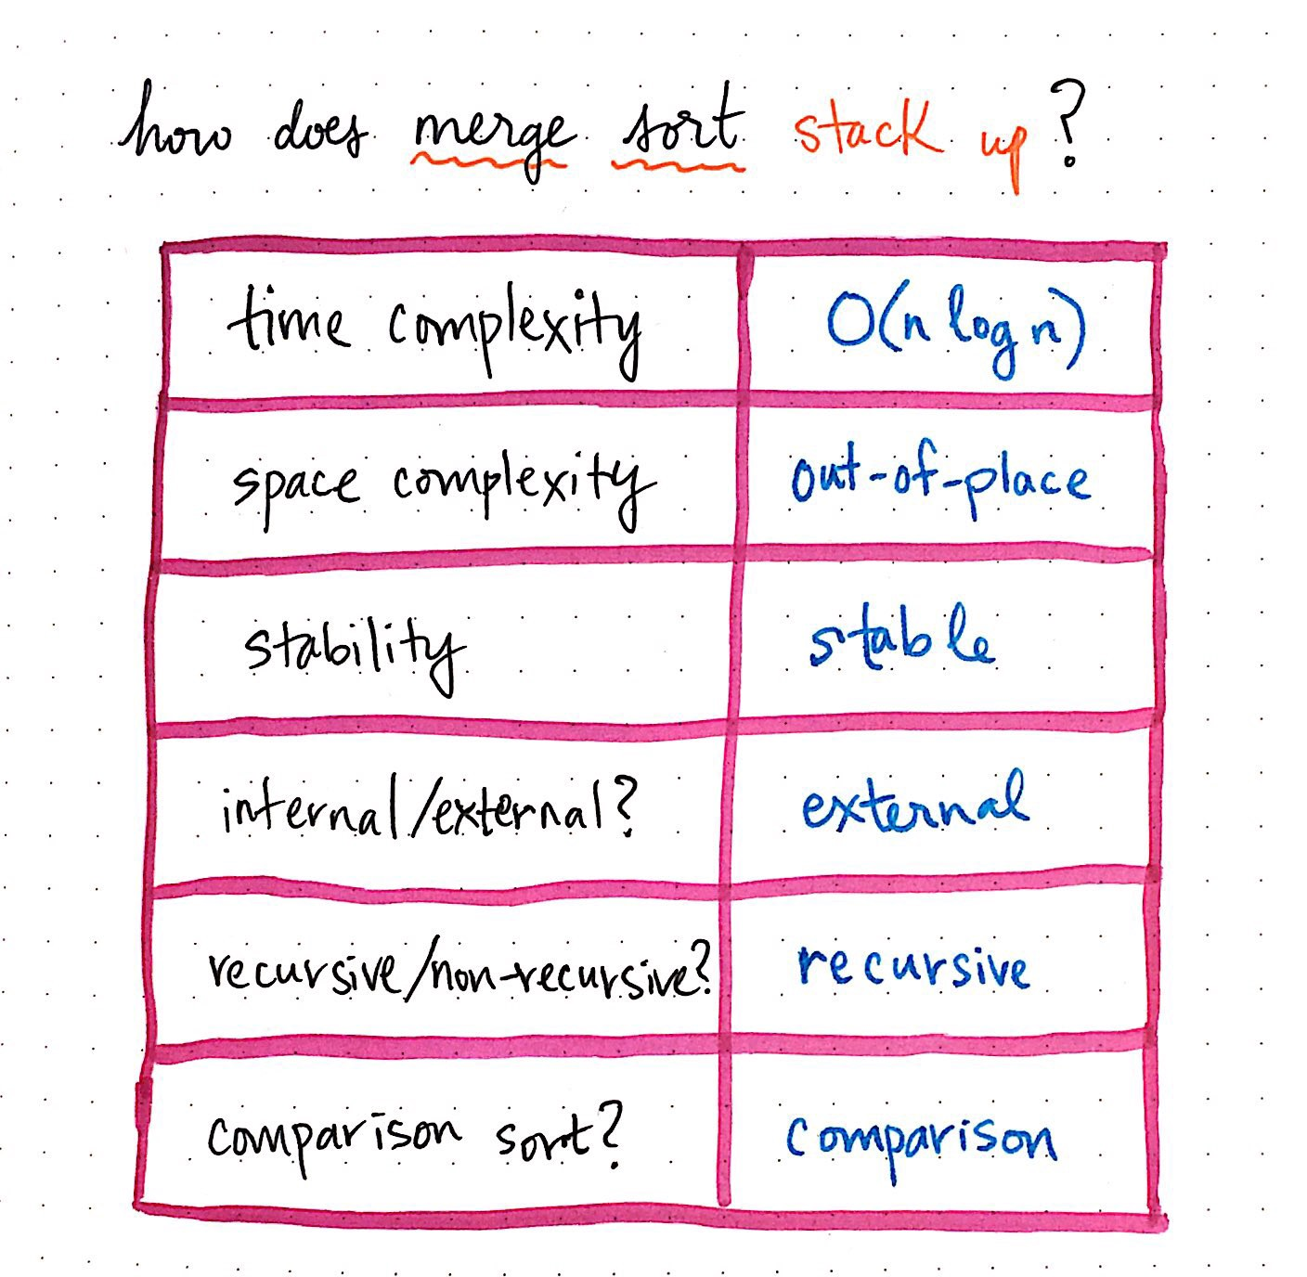
Merge Sort

Slide 18
QuickSort
Notes:
‹#›

Slide 19
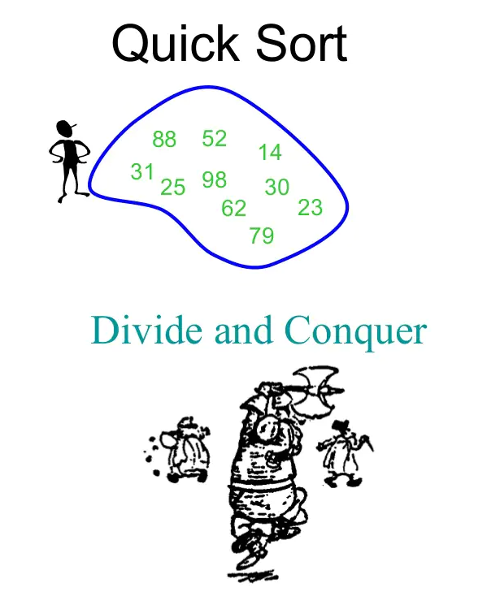
Quick Sort

Slide 20
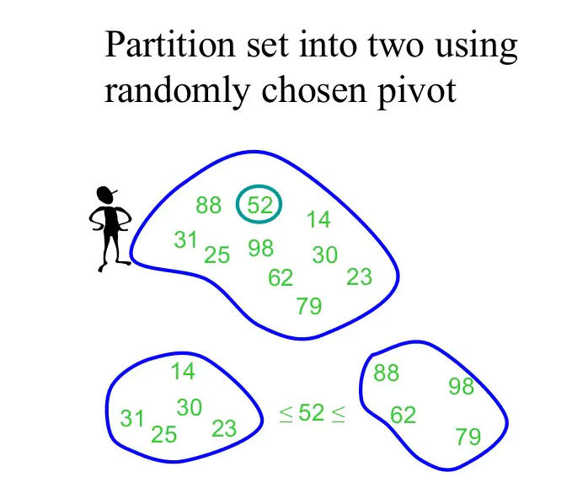
Quick Sort

Slide 21
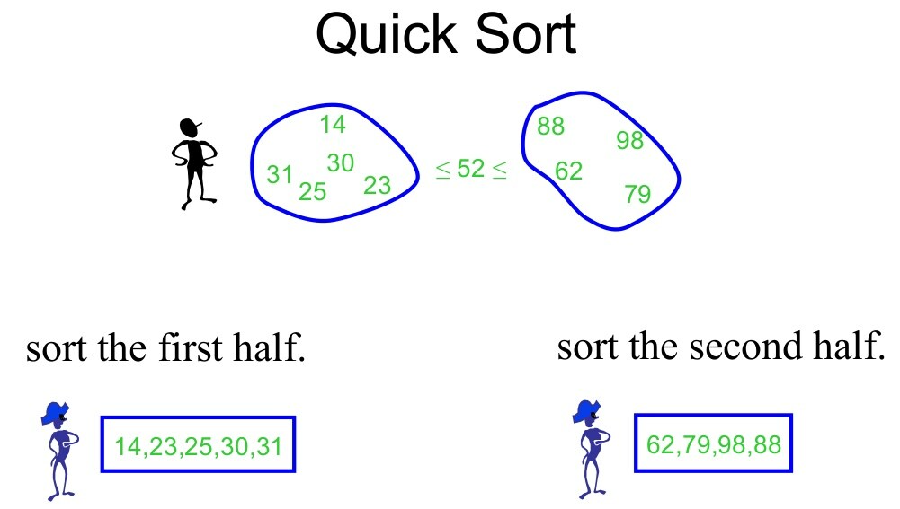
Quick Sort

Slide 22
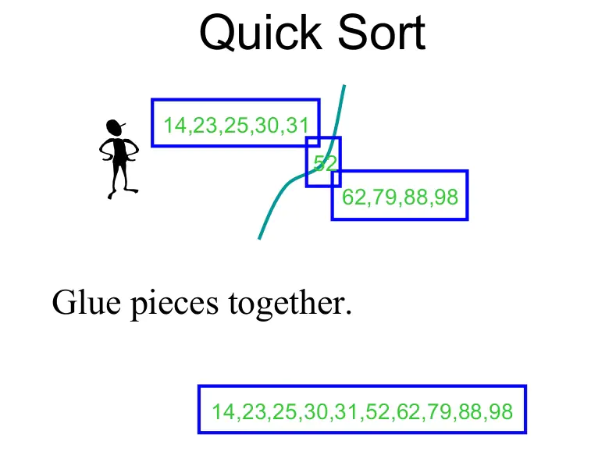
Quick Sort

Slide 23
Quick Sort: Design
Follows the divide-and-conquer paradigm
Divide: Partition (separate) the array A[p..r] into two (possibly nonempty) subarrays A[p..q-1] and A[q+1..r].
Each element in A[p..q-1]<=A[q]
A[q]<= each element in A[q+1,r]
Index q is computed as part of the partitioning procedure.
Conquer: Sort the two subarrays A[p..q-1]& A[q+1.. r]by recursive calls to quicksort.
Combine: Since the subarrays are sorted in place-no work is needed to combine them.

Slide 24
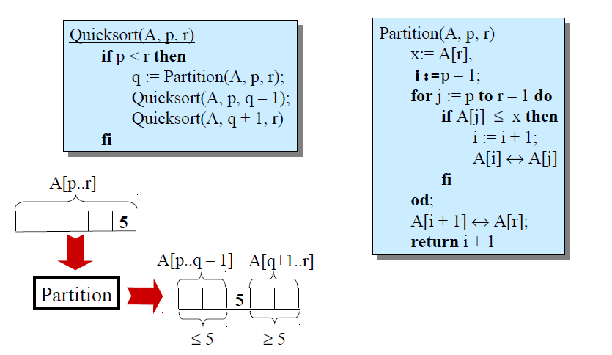
Quick Sort: Pseudocode

Slide 25
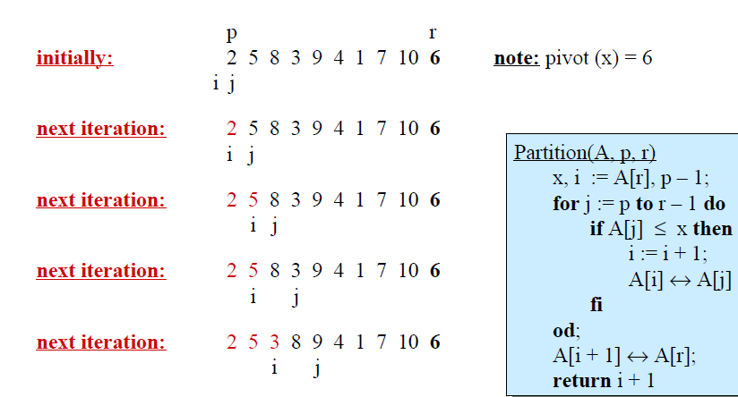
Quick Sort: Example

Slide 26
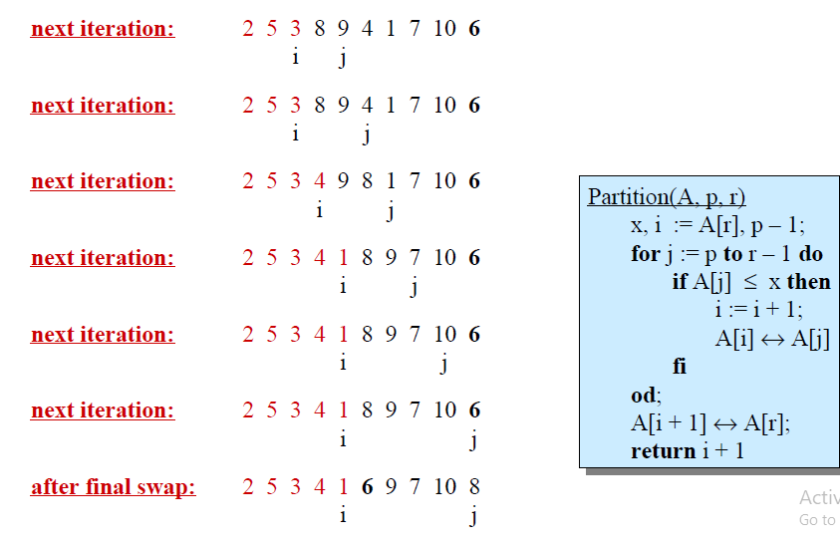
Quick Sort: Example

Slide 27
Algorithm Performance
Running time of quicksort depends on whether the partitioning is balanced or not.
Worst-case partitioning(unbalanced partitions):
Occurs when every call to partition results in the most unbalanced partition.
Partition is most unbalanced when
Subproblem 1 is of size n-1, and subproblems 2 is of size 0 or vice versa.
pivot>=every element in A[p..r-1] or pivot < every element in A[p..r-1]
Every call to partition is most unbalanced when
Array A[1..n] is sorted or reverse sorted.

Slide 28
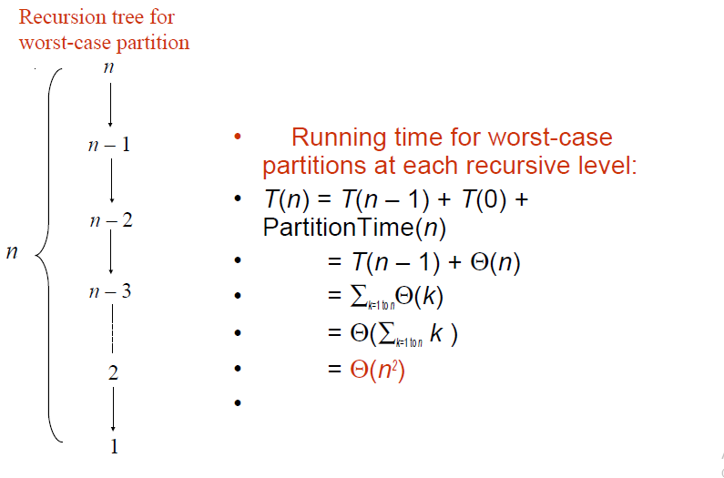
Worst-case Partition Anaysis

Slide 29
Best-case Partitioning
Size of each subproblem <=n/2.
one of the subproblems is of size n/2
the other is of size n/2-1
Recurrence for running time
T(n)<=2T(n/2)+Partition Time(n)
= 2T(n/2)+Θ(n)
T(n)=Θ(n lg n)

Slide 30
Randomized QuickSort
Notes:
‹#›

Slide 31
Randomized QuickSort
An algorithm is randomized if its behavior is determined not only by the input but also by values produced by a random-number generator.
Exchange A[r] with an element chosen at random from A[p...r] in Partition.
This ensures that the pivot element is equally likely to be any of input elements
We can sometimes add randomization to an algorithm in order to obtain good average-case performance over all inputs.

Slide 32
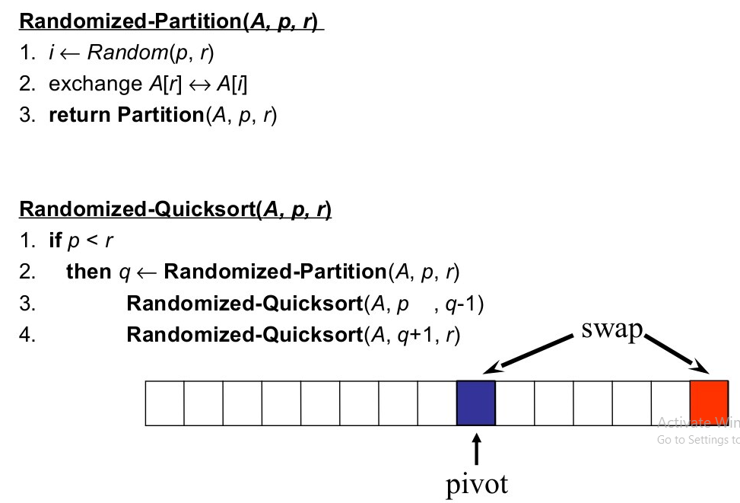
Randomized QuickSort

Slide 33
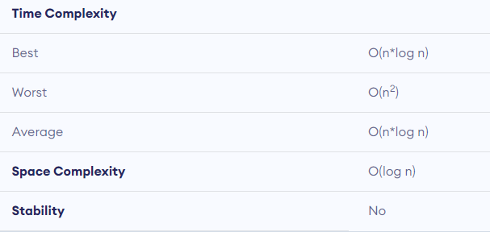
QuickSort

